Slide 1
Unix Programming
Project – vi editor
14109345 성 현 준
15109351 이 수 진
15109370 정 혜 수
16170062 가르니에 조리스
16170070 천신

Slide 2
INDEX
01 Scenario
02 Vi Editor Code
03 Preview
04 Contemplation

Slide 3
01 Scenario
Open file temporarily on the name of ‘main argument’
Start window and divide screen to ‘Edit Window’ and ‘Command Window’.
File open and Load.
Selecting Mode – Command Mode, Insert Mode.
Command Mode ESC Mode “ :w ” – Save File “ :q “ – Close the File and Exit from Window “ x “ – Delete one Character “ d “ – 1) “d” : Delete one line 2) “w” : Delete one word Insert Character
Insert Mode Backspace – Delete the current character Arrow Key – Move the current cursor position Enter

Slide 4
02 Vi Editor Code - Role
Role
성현준 : ‘main’ Function & Outline of the codes
이수진 : Command Mode Functions
정혜수 : Insert Mode Functions
가르니에 조리스 & 천신 : File Save Function & Get last Line / Character

Slide 5
02 Vi Editor Code - Command Mode
Command Mode
When input “a” in ESC Mode it turn to Insert Mode and the cursor will be locate on the right of current position.
getyx -> wmove(++x) -> Insert Mode
When input “x” in ESC Mode it calls this function. Delete 1 character.
getyx -> wmove(--x) -> wdelch

Slide 6
02 Vi Editor Code - Command Mode
Command Mode
When input “d” in ESC Mode it calls this function. Input “d” again, delete 1 line. Input “w”, delete 1 word.
getyx -> wgetch -> “d” -> wdeleteln
-> “w” -> wdelch
When input “r” in ESC Mode it calls this function. Replacing the character at current position.
getyx -> wmove -> wdelch -> getch -> winsch

Slide 7
02 Vi Editor Code - Insert Mode
Insert Mode
At Insert Mode if, input ‘Enter’, cursor goes down to next line.
At Insert Mode, if input any character, it will displayed on the window.
getyx -> winsch -> wmove(++x)
At Insert Mode, if input ‘Backspace’, it will delete 1 character on current position.
getyx -> wmove(--x) -> wdelch

Slide 8
02 Vi Editor Code - Other Modes
Other Modes
When input “:w” in ESC Mode, file will be save at current directory.
winch -> write ->wmove(++x)

Slide 9
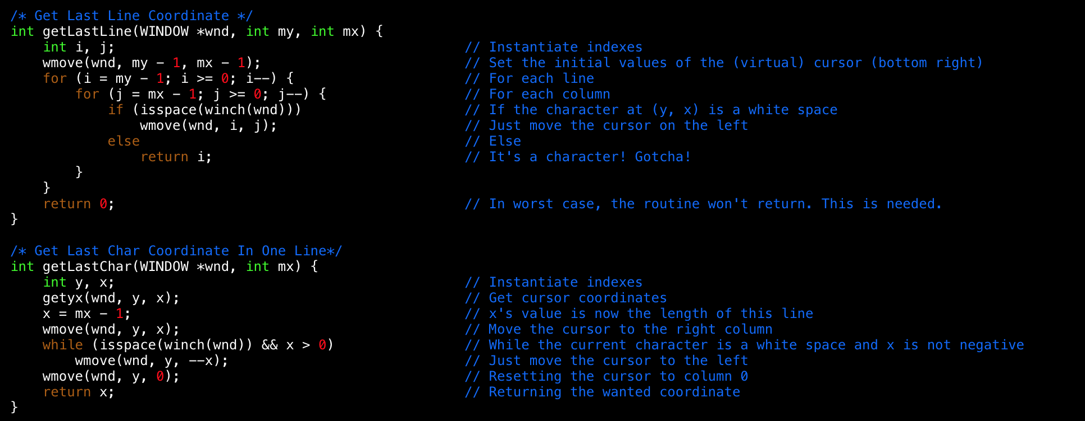
02 Vi Editor Code - Other Modes
Other Modes

Slide 10

02 Vi Editor Code - Setup Mode
Setup Mode
Initialize Window.
At any modes, cursor will move when press Arrow keys.
getyx -> wmove(up, down, left, right)
It print the current mode description or lines of file at Command Window.
get(max)yx -> wclrtoeol(cmd) -> mvwprintw(prompt & line)

Slide 11
02 Vi Editor Code - Main
Main
File Make
Window Start
Divide Screen – Edit / Command
Permit Special Character
File Open and Load
Mode Control
Command Mode
Colon Mode
Insert Mode

Slide 12
03 Preview

Slide 13
04 Contemplation
Architecting the Outline of code
File loading after File Save
Insert “Enter” at Insert Mode
Optimization

Slide 14
Q & A

Slide 15
THANK YOU

